Slide 1
Fall Design Presentation
AI-Powered OPV Design

Slide 2
Members
Advisor: Dr. Mohsen Rezayat
Milo Ginn
Ido gal
Om Jadhav
Toan Nham
Dhruv Pratap Singh

Slide 3
Purpose
Goal:
  Design and develop transparent, cost-effective photovoltaic (PV) cells optimized for farming and greenhouse applications.
Functionality:
  Generate renewable energy while maintaining sunlight transmission for plant growth.
  Enhance energy efficiency and support sustainable agriculture.
Integration:
  Incorporate PV technology directly into greenhouse structures.
  Enable simultaneous energy generation and crop cultivation.
Outcomes:
  Reduce operational costs for farmers.
  Lower carbon footprint and environmental impact.
  Promote self-sufficient, eco-friendly food production systems.

Slide 4
Abstract
Objective:
  Develop transparent, cost-effective photovoltaic (PV) cells for farming and greenhouse use.
Innovation:
  Combine solar energy generation with light transmission needed for optimal plant growth.
Approach:
  Utilize thin-film materials and spectrally selective coatings.
  Employ low-cost, scalable manufacturing techniques.
Benefits:
  Dual functionality – energy production + crop cultivation.
  Reduced energy costs and lower carbon footprint.
  Supports sustainable and self-sufficient agriculture.
Impact:
  Enables energy-positive greenhouses.
  Promotes smart, sustainable farming systems.
  Contributes to climate resilience and food security.

Slide 5
Use Cases for Transparent OPV Panels
Vineyard Owner
Install transparent OPV panels above crops to generate renewable energy without reducing grape quality and protect from excess heat.
Farm Worker
Use lightweight, easy-to-install OPV panels to manage the vineyard without complex tools or training.
Farmer
Apply transparent, sturdy, and flexible OPV panels on greenhouse roofs to generate electricity without blocking needed sunlight.
Farm Equipment Operator
Adopt cost-effective OPV panels to offset operational energy costs.
Architect
Integrate efficient, affordable OPV panels into building designs to increase natural light and reduce operating costs.
Homeowner
Install lightweight OPV panels on rooftops to lower electricity bills without structural changes.
Panel Designer
Leverage open-source AI models to enhance OPV panel efficiency.

Slide 6
Key Constraints & Considerations
Economic:
  OPV fabrication/testing is costly → use open-source tools & university resources.
  Limited funding → focus on efficient materials & low-cost modeling.
Environmental:
  Must be non-toxic, weather-resistant, recyclable.
  Optimize light transmission to protect crop and soil health.
Ethical & Social:
  Support farmers without reducing jobs or access to green tech.
  Commit to data transparency and open collaboration for global impact.
Professional & Legal:
  Respect IP rights, citations, and licenses for datasets and AI tools.
Security & Privacy:
  Ensure safe storage and sharing of AI models and simulation data.

Slide 7
Design Diagrams

Slide 8

Design Diagrams

Slide 9
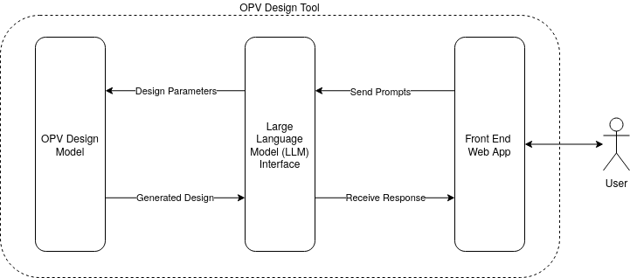
Design Diagrams

Slide 10
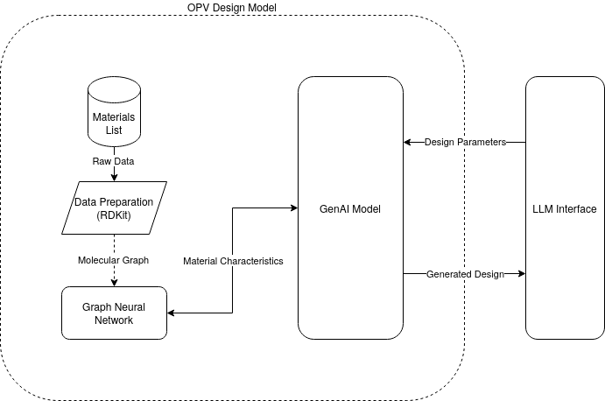
Design Diagrams

Slide 11
Expected Accomplishments-First Semester
Foundation & Exploration
Gain a solid understanding of OPV data, material properties, and system requirements.
Conduct a literature review on OPV materials, canopy geometry, and AI-based optimization methods.
Define project goals, constraints, and success metrics.
Begin exploring data preprocessing and model architecture design ideas.

Slide 12
Division of Work
Task | Team Member(s) | Start Date | End Date
Research OPV principles and system setup | All | Aug 2025 | Sep 2025
Design UI/UX Mockup | Milo | Oct 2025 | Oct 2025
Develop front-end skeleton | Milo | Oct 2025 | Nov 2025
Integrate API communication with LLM | Milo | Dec 2025 | Feb 2026
Research existing LLM models | Dhruv | Sep 2025 | Oct 2025
Develop initial LLM model | Dhruv | Oct 2025 | Nov 2025
Integrate outside data sources (GenAI section) in LLM | Dhruv | Dec 2025 | Feb 2026
Research GNN implementation options | Om | Sep 2025 | Oct 2025
Write GNN implementation code | Om | Oct 2025 | Dec 2025
Train GNN with input data | Om | Dec 2025 | Jan 2026
Test data against real-world examples | Ido | Jan 2026 | Feb 2026
Select and refine the best-performing GNN model | Ido | Feb 2026 | Mar 2026
Research GenAI model types | Toan | Sep 2025 | Oct 2025
Develop general GenAI model structure | Toan | Oct 2025 | Nov 2025
Train GenAI model on sample data | Toan | Nov 2025 | Jan 2026
Test GenAI model accuracy | Toan | Jan 2026 | Feb 2026
Research data structure representation | Ido | Sep 2025 | Oct 2025
Implement input processing functions | Ido | Oct 2025 | Nov 2025
Integration Testing and Debugging | All | Feb 2026 | Mar 2026
Final Presentation and Documentation | All | Mar 2026 | Apr 2026

Slide 13
Expected Demo
Poster showcasing research and development
Recording of interaction with LLM
Possible Live service

